Slide 1
Anonymous Block In TSQL
By-
Shailendra Yadav

Slide 2
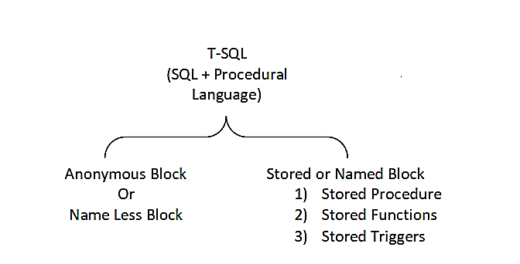

Slide 3
Anonymous Block OR Name Less Block

Slide 4
Definition:
The T-SQL anonymous block statement is an executable statement that can contain T-SQL control statements and SQL statements.

Slide 5
Block Structure:
The anonymous block has three basic sections that are the declaration, execution, and exception handling.
Only the execution section is mandatory and the others are optional.

Slide 6
Block Structure:
[DECLARE]
BEGIN
[EXCEPTION]
END;
declare variables and constants
lists executable statements
error handling section
ends the block
Declarations and exceptions are optional

Slide 7
Declaration Section :
The declaration section allows you to define data types, structures, and variables.
We often declare variables in the declaration section by giving them names, data types, and initial values.

Slide 8
Execution Section:
The execution section is required in a block structure and it must have at least one statement.
The execution section is the place where you put the execution code or business logic code.

Slide 9
Exception Handling Section:
The exception handling section is starting with the EXCEPTION keyword.
The exception section is the place that you put the code to handle exceptions.

Slide 10
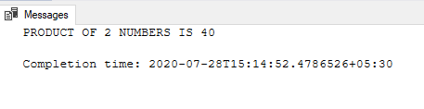
Example:
DECLARE @X INT, @Y INT,@Z INT SET @X = 5 SET @Y = 8 SET @Z = @X * @Y PRINT 'PRODUCT OF 2 NUMBERS IS ‘ + CAST(@Z AS VARCHAR(5))
Output:

Slide 11
Advantages:
We do not need to declare it in advance and we can specify it dynamically.
Anonymous block is used when you don't want to create a procedure or function in database.

Slide 12
Thankyou

